Slide 1
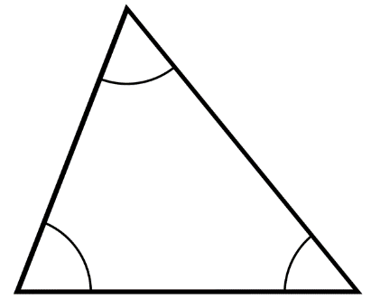
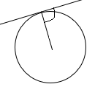
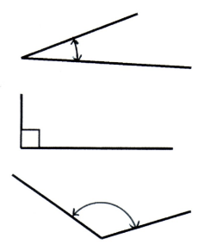
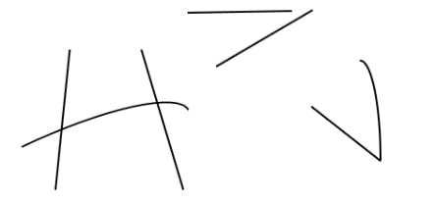
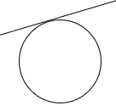
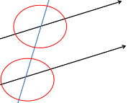
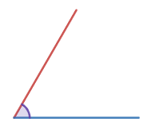
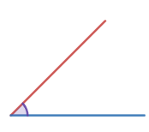
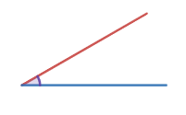



Subtopic G1.3 – Estimating Angles
LEARNING OUTCOME: To be able to estimate the size of angles
Objectives:
Keywords:
Angle
Acute
Obtuse
Reflex
To be able to estimate the size of acute angles
To be able to estimate the size of obtuse angles
To be able to estimate the size of reflex angles
Definition
Characteristics
Two connected straight lines
Often measured using the unit “degree”
Often measured using a protractor
Can be called “acute”, “obtuse”, “reflex” and “right”
The amount of turn from one straight line to another straight line connected at a point
Angle
Examples
Non - Examples
To be able to estimate the size of acute angles
 | Example 1 – I do… | Example 2 – We do… | Example 3 – You do…
Steps | Estimate the size of the angle shown: | Estimate the size of the angle shown. | Estimate the size of the angle shown.
Draw on a perpendicular line to one of the edges to help give a sense of perspective. Use this to estimate how large your angle is.

Slide 2
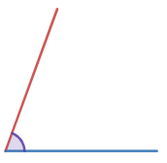
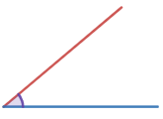




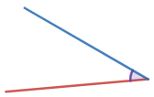
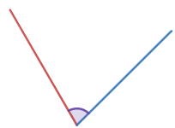
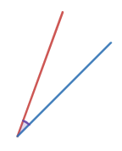



Independent Practice
Question 1. Estimate the size of the angles shown below:
a)
b)
c)
d)
e)
f)
Question 2.
a) In the spaces below, without a protractor, sketch the following angles:
b) Now go back and measure the angles with a protractor. How close were you to the exact value?

Slide 3






Question 3. Look at the shape below. Estimate the following angles:
______________________________________________________________________________________________________________________________________________________________________________________________________________________________________________________ ____________________________________________________________________________________________________________________________________________________________________
T
A
Q
B
C
E
R
G
D
P
H
F
J
K
N
M
L

Slide 4
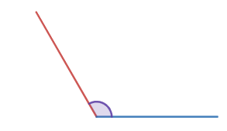
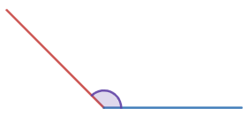




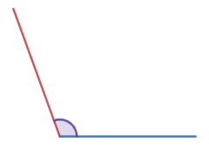
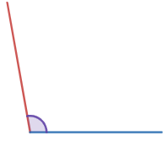
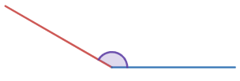



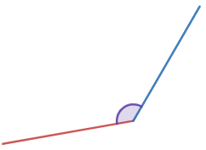
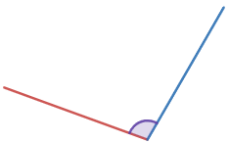




To be able to estimate the size of obtuse angles
 | Example 4 – I do… | Example 5 – We do… | Example 6 – You do…
Steps | Estimate the size of the angle shown: | Estimate the size of the angle shown. | Estimate the size of the angle shown.
Independent Practice
Question 4. Estimate the size of the angles shown below:
a)
b)
c)
d)
e)
f)

Slide 5
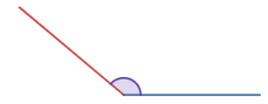

Question 5. In the spaces below, without a protractor, sketch the following angles:
b) Now go back and measure the angles with a protractor. How close were you to the exact value?
a) Without measuring, how can we tell Musa is incorrect?
______________________________________________________________________________________________________________________________________________________________________________________________________________________________________________________ __________________________________________________________________________________
b) What is a more suitable estimate for this angle?

Slide 6






Question 7. Look at the shape below. Which of the angles in the shape are likely to be the following size?
g) Evan says “if the lines are longer, that means the angle will be bigger too”. Do you agree? Justify your answer
______________________________________________________________________________________________________________________________________________________________________________________________________________________________________________________ __________________________________________________________________________________
A
B
K
C
J
D
H
G
E
F
No, angles are a measure of turn, this isn’t affected by the length of the lines.

Slide 7
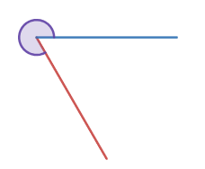

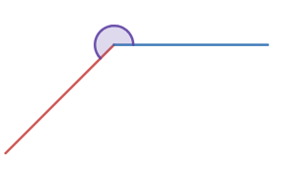



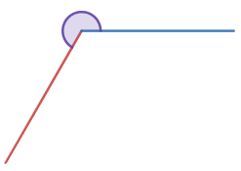
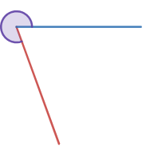
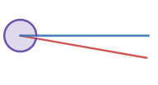



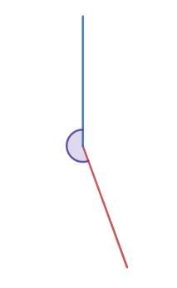
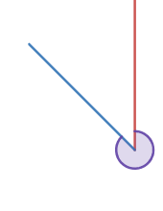
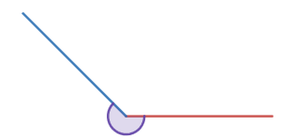



Estimating the size of reflex angles
 | Example 7 – I do… | Example 8 – We do… | Example 9 – You do…
Steps | Estimate the size of angle shown. | Estimate the size of angle shown. | Estimate the size of angle shown.
Independent Practice
Question 8. Estimate the size of the angles shown below:
a)
b)
c)
d)
e)
f)

Slide 8
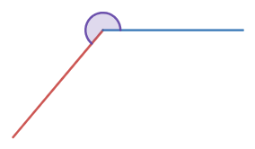

Question 9. In the spaces below, without a protractor, sketch the following angles:
b) Now go back and measure the angles with a protractor. How close were you to the exact value?
a) Without measuring, how can we tell Tariq is incorrect?
______________________________________________________________________________________________________________________________________________________________________________________________________________________________________________________ __________________________________________________________________________________
b) What is a more suitable estimate for this angle?

Slide 9
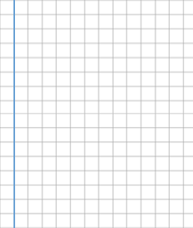












Question 11. Estimate the size of the following angles between the points:
A
B
C
D
E
F
G
H
I
J
K
L
M
O
P
Q
R
S
T
U

Slide 10
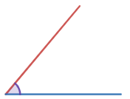









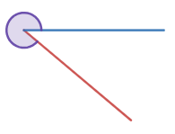




Skills Check
Which of the following is a suitable estimate for the angle shown?
Which of the following is a suitable estimate for the angle shown?
Which of the following is a suitable estimate for the angle shown?

